Slide 1

STATS 432 Computational Statistics
Tutorial 4 – Markov Chains

Slide 2

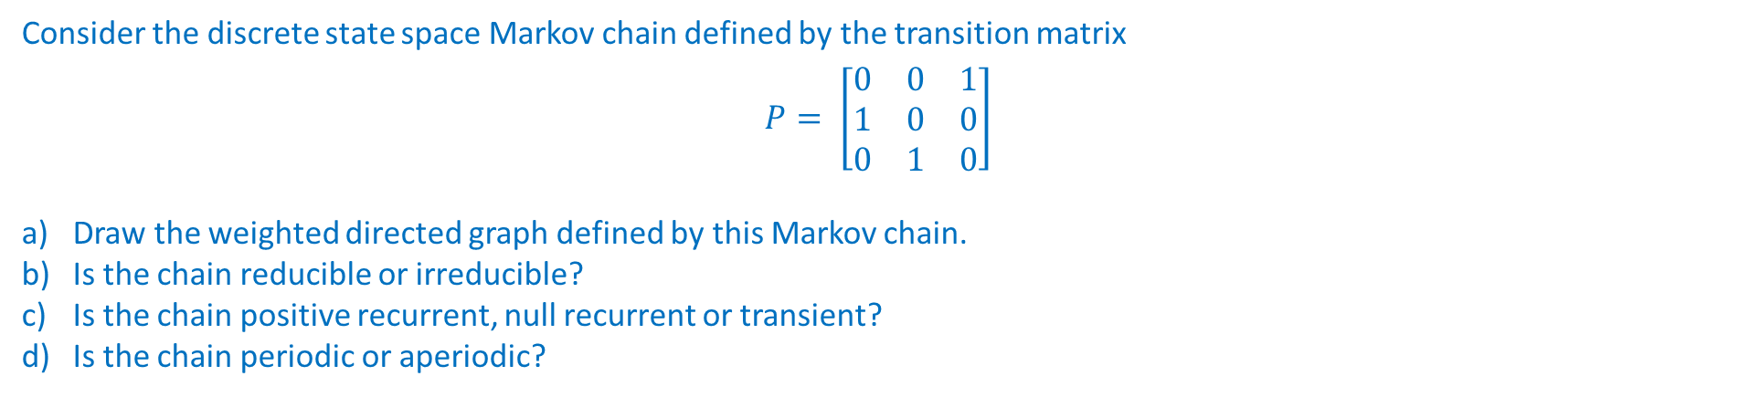
Question 1 :
Question 1
Consider the discrete state space Markov chain defined by the transition matrix
$$P= \left[\begin{matrix}0 & 0 & 1 \\ 1 & 0 & 0 \\ 0 & 1 & 0\end{matrix}\right]$$
Draw the weighted directed graph defined by this Markov chain.
Is the chain reducible or irreducible?
Is the chain positive recurrent, null recurrent or transient?
Is the chain periodic or aperiodic?
2

Slide 3
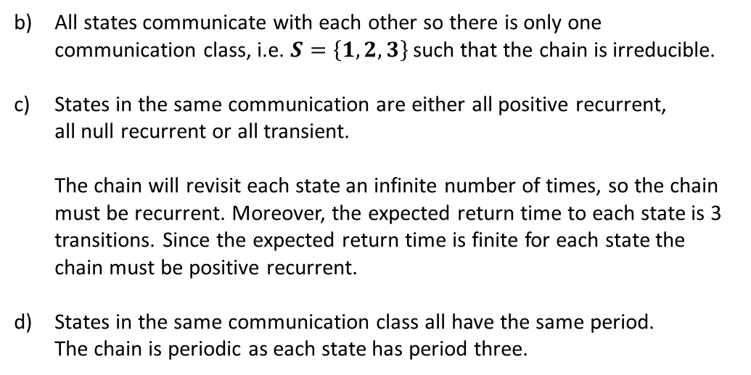
Question 1 :
Question 1
Consider the discrete state space Markov chain defined by the transition matrix
$$P= \left[\begin{matrix}0 & 0 & 1 \\ 1 & 0 & 0 \\ 0 & 1 & 0\end{matrix}\right]$$
Draw the weighted directed graph defined by this Markov chain.
Is the chain reducible or irreducible?
Is the chain positive recurrent, null recurrent or transient?
Is the chain periodic or aperiodic?
All states communicate with each other so there is only one communication class, i.e. $S=\left\{1,2,3\right\}$ such that the chain is irreducible.
States in the same communication are either all positive recurrent, all null recurrent or all transient. The chain will revisit each state an infinite number of times, so the chain must be recurrent. Moreover, the expected return time to each state is 3 transitions. Since the expected return time is finite for each state the chain must be positive recurrent.
States in the same communication class all have the same period. The chain is periodic as each state has period three.
1
1.0
2
1.0
3
1.0
3

Slide 4
Question 2:
Question 2
Consider the discrete state space Markov chain defined by the weighted directed graph shown below
1
Write out the transition matrix defined by this Markov chain.
Is the chain reducible or irreducible?
State whether each communication class is positive recurrent, null recurrent or transient?
State whether each communication class periodic or aperiodic?
5
2
4
3
6
7
4

Slide 5
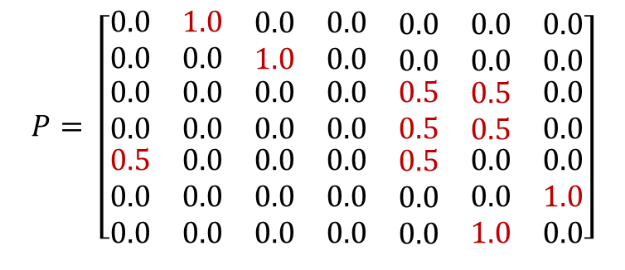
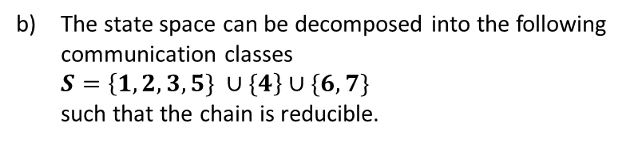
Question 2:
Question 2
Consider the discrete state space Markov chain defined by the weighted directed graph shown below
1
Write out the transition matrix defined by this Markov chain.
Is the chain reducible or irreducible?
State whether each communication class is positive recurrent, null recurrent or transient?
State whether each communication class periodic or aperiodic?
5
2
$$P= \left[\begin{matrix}0.0 & 1.0 & \begin{matrix}0.0 & 0.0 & \begin{matrix}0.0 & 0.0 & 0.0\end{matrix}\end{matrix} \\ 0.0 & 0.0 & \begin{matrix}1.0 & 0.0 & \begin{matrix}0.0 & 0.0 & 0.0\end{matrix}\end{matrix} \\ \begin{matrix}0.0 \\ 0.0 \\ \begin{matrix}0.5 \\ 0.0 \\ 0.0\end{matrix}\end{matrix} & \begin{matrix}0.0 \\ 0.0 \\ \begin{matrix}0.0 \\ 0.0 \\ 0.0\end{matrix}\end{matrix} & \begin{matrix}\begin{matrix}0.0 \\ 0.0 \\ \begin{matrix}0.0 \\ 0.0 \\ 0.0\end{matrix}\end{matrix} & \begin{matrix}0.0 \\ 0.0 \\ \begin{matrix}0.0 \\ 0.0 \\ 0.0\end{matrix}\end{matrix} & \begin{matrix}\begin{matrix}0.5 \\ 0.5 \\ \begin{matrix}0.5 \\ 0.0 \\ 0.0\end{matrix}\end{matrix} & \begin{matrix}0.5 \\ 0.5 \\ \begin{matrix}0.0 \\ 0.0 \\ 1.0\end{matrix}\end{matrix} & \begin{matrix}0.0 \\ 0.0 \\ \begin{matrix}0.0 \\ 1.0 \\ 0.0\end{matrix}\end{matrix}\end{matrix}\end{matrix}\end{matrix}\right]$$
4
3
6
The state space can be decomposed into the following communication classes $S=\left\{1,2,3,5\} ∪\{4\right\}∪\{6,7\}$ such that the chain is reducible.
7
5

Slide 6
Question 2:
Question 2
Consider the discrete state space Markov chain defined by the weighted directed graph shown below
1
Write out the transition matrix defined by this Markov chain.
Is the chain reducible or irreducible?
State whether each communication class is positive recurrent, null recurrent or transient?
State whether each communication class periodic or aperiodic?
5
2
States in the same communication class are either all positive recurrent, all null recurrent or all transient. {1,2,3,5} are transient states as it is not certain that the chain will return to these states in the future {4} is a transient state as the chain never returns here {6,7} are positive recurrent as the chain is guaranteed to return to state 6 or 7 in two transitions.
4
3
6
7
States in the same communication class all have the same period. {1,2,3,5} have period 1 (aperiodic) due to existence of self-loop at 5 {4} has ill-defined period (chain never returns). {6,7} have period 2.
6

Slide 7
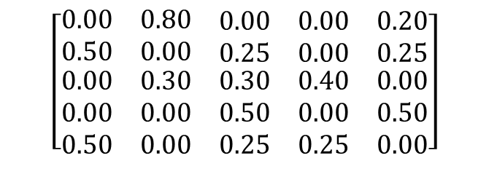

Question 3:
Question 3
0.5
1
0.8
Consider the discrete state space Markov chain defined below
0.2
0.5
1
2
3
4
5
5
2
0.25
1
$$\left[\begin{matrix}0.00 & 0.80 & \begin{matrix}0.00 & 0.00 & 0.20\end{matrix} \\ 0.50 & 0.00 & \begin{matrix}0.25 & 0.00 & 0.25\end{matrix} \\ \begin{matrix}0.00 \\ 0.00 \\ 0.50\end{matrix} & \begin{matrix}0.30 \\ 0.00 \\ 0.00\end{matrix} & \begin{matrix}\begin{matrix}0.30 \\ 0.50 \\ 0.25\end{matrix} & \begin{matrix}0.40 \\ 0.00 \\ 0.25\end{matrix} & \begin{matrix}0.00 \\ 0.50 \\ 0.00\end{matrix}\end{matrix}\end{matrix}\right]$$
2
0.25
0.3
$$P=$$
3
0.25
0.25
4
5
0.5
4
3
0.4
0.3
What conditions ensure that a discrete state space Markov chain has a stationary distribution? Are these conditions satisfied here? If so, find the stationary distribution.
What conditions ensure that a discrete state space Markov chain has a limiting distribution? Are these conditions satisfied here?
Given your answer to the above, give an expression for $\lim_{n →∞}{P\left( X^{\left(n\right)}=j \right)}$ for each $j=1, …, 5$
Give an expression for $\lim_{n→∞}{P^{n}}$. Check your answer by raising the matrix $P$ to successively higher powers in R.
7
Associated code = Tutorial 4 – Q3

Slide 8
Question 3:
Question 3
0.5
1
0.8
Consider the discrete state space Markov chain defined below
0.2
0.5
1
2
3
4
5
5
2
0.25
1
$$\left[\begin{matrix}0.00 & 0.80 & \begin{matrix}0.00 & 0.00 & 0.20\end{matrix} \\ 0.50 & 0.00 & \begin{matrix}0.25 & 0.00 & 0.25\end{matrix} \\ \begin{matrix}0.00 \\ 0.00 \\ 0.50\end{matrix} & \begin{matrix}0.30 \\ 0.00 \\ 0.00\end{matrix} & \begin{matrix}\begin{matrix}0.30 \\ 0.50 \\ 0.25\end{matrix} & \begin{matrix}0.40 \\ 0.00 \\ 0.25\end{matrix} & \begin{matrix}0.00 \\ 0.50 \\ 0.00\end{matrix}\end{matrix}\end{matrix}\right]$$
2
0.25
0.3
$$P=$$
3
0.25
0.25
4
5
0.5
4
3
0.4
0.3
What conditions ensure that a discrete state space Markov chain has a stationary distribution? Are these conditions satisfied here? If so, find the stationary distribution.
If a discrete state space Markov chain is irreducible and positive recurrent, => it has a stationary distribution (see Theorem 5 of lecture notes).
This chain is irreducible (only one communication class) and positive recurrent (an irreducible Markov chain with a finite state space can’t be transient or null recurrent). As such the chain has a stationary distribution.
8
Associated code = Tutorial 4 – Q3

Slide 9
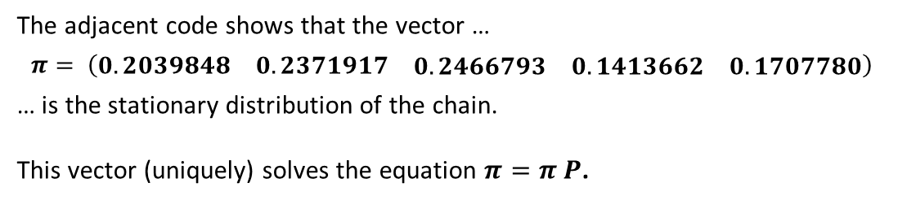
Question 3:
Question 3
0.5
1
0.8
Consider the discrete state space Markov chain defined below
0.2
0.5
1
2
3
4
5
5
2
0.25
1
$$\left[\begin{matrix}0.00 & 0.80 & \begin{matrix}0.00 & 0.00 & 0.20\end{matrix} \\ 0.50 & 0.00 & \begin{matrix}0.25 & 0.00 & 0.25\end{matrix} \\ \begin{matrix}0.00 \\ 0.00 \\ 0.50\end{matrix} & \begin{matrix}0.30 \\ 0.00 \\ 0.00\end{matrix} & \begin{matrix}\begin{matrix}0.30 \\ 0.50 \\ 0.25\end{matrix} & \begin{matrix}0.40 \\ 0.00 \\ 0.25\end{matrix} & \begin{matrix}0.00 \\ 0.50 \\ 0.00\end{matrix}\end{matrix}\end{matrix}\right]$$
2
0.25
0.3
$$P=$$
3
0.25
0.25
4
5
0.5
4
3
0.4
0.3
What conditions ensure that a discrete state space Markov chain has a stationary distribution? Are these conditions satisfied here? If so, find the stationary distribution.
# 1.1a - Define transition matrix P
statenames <- c("1", "2", "3", "4" , "5" )
P <- matrix( c(
0.00, 0.80, 0.00, 0.00, 0.20,
0.50, 0.00, 0.25, 0.00, 0.25,
0.00, 0.30, 0.30, 0.40, 0.00,
0.00, 0.00, 0.50, 0.00, 0.50,
0.50, 0.00, 0.25, 0.25, 0.00), nrow=5, byrow=TRUE,
dimnames = list(statenames, statenames))
# 1.1b - Specifying that the transition matrix P defines a Markov chain
mcp <- new("markovchain", transitionMatrix=P)
# 1.1c - Determine the stationary distribution of the Markov chain defined by P
steadyStates(mcp)
1 2 3 4 5
[1,] 0.2039848 0.2371917 0.2466793 0.1413662 0.170778
The adjacent code shows that the vector …
$$π= \left(\begin{matrix}0.2039848 & 0.2371917 & \begin{matrix}0.2466793 & 0.1413662 & 0.1707780\end{matrix}\end{matrix}\right)$$
… is the stationary distribution of the chain.
This vector (uniquely) solves the equation $π=π P$.
9
Associated code = Tutorial 4 – Q3

Slide 10
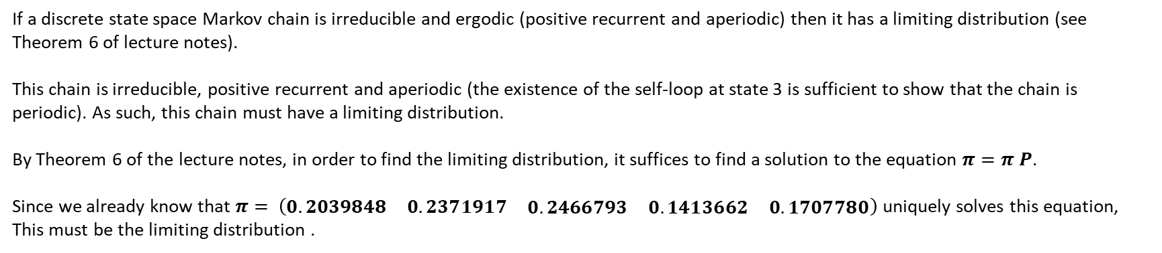
Question 3:
Question 3
0.5
1
0.8
Consider the discrete state space Markov chain defined below
0.2
0.5
1
2
3
4
5
5
2
0.25
1
$$\left[\begin{matrix}0.00 & 0.80 & \begin{matrix}0.00 & 0.00 & 0.20\end{matrix} \\ 0.50 & 0.00 & \begin{matrix}0.25 & 0.00 & 0.25\end{matrix} \\ \begin{matrix}0.00 \\ 0.00 \\ 0.50\end{matrix} & \begin{matrix}0.30 \\ 0.00 \\ 0.00\end{matrix} & \begin{matrix}\begin{matrix}0.30 \\ 0.50 \\ 0.25\end{matrix} & \begin{matrix}0.40 \\ 0.00 \\ 0.25\end{matrix} & \begin{matrix}0.00 \\ 0.50 \\ 0.00\end{matrix}\end{matrix}\end{matrix}\right]$$
2
0.25
0.3
$$P=$$
3
0.25
0.25
4
5
0.5
4
3
0.4
0.3
What conditions ensure that a discrete state space Markov chain has a limiting distribution? Are these conditions satisfied here?
If a discrete state space Markov chain is irreducible and ergodic (positive recurrent and aperiodic) then it has a limiting distribution (see Theorem 6 of lecture notes).
This chain is irreducible, positive recurrent and aperiodic (the existence of the self-loop at state 3 is sufficient to show that the chain is periodic). As such, this chain must have a limiting distribution.
By Theorem 6 of the lecture notes, in order to find the limiting distribution, it suffices to find a solution to the equation $π=π P$.
Since we already know that $π= \left(\begin{matrix}0.2039848 & 0.2371917 & \begin{matrix}0.2466793 & 0.1413662 & 0.1707780\end{matrix}\end{matrix}\right)$ uniquely solves this equation,
This must be the limiting distribution .
10
Associated code = Tutorial 4 – Q3

Slide 11
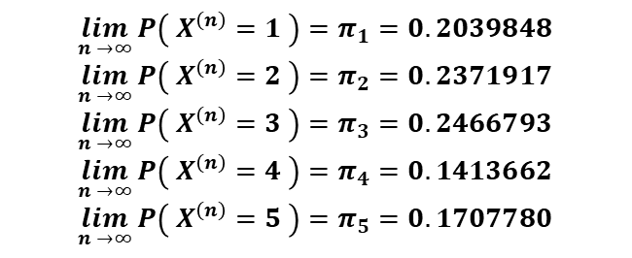
Question 3:
Question 3
0.5
1
0.8
Consider the discrete state space Markov chain defined below
0.2
0.5
1
2
3
4
5
5
2
0.25
1
$$\left[\begin{matrix}0.00 & 0.80 & \begin{matrix}0.00 & 0.00 & 0.20\end{matrix} \\ 0.50 & 0.00 & \begin{matrix}0.25 & 0.00 & 0.25\end{matrix} \\ \begin{matrix}0.00 \\ 0.00 \\ 0.50\end{matrix} & \begin{matrix}0.30 \\ 0.00 \\ 0.00\end{matrix} & \begin{matrix}\begin{matrix}0.30 \\ 0.50 \\ 0.25\end{matrix} & \begin{matrix}0.40 \\ 0.00 \\ 0.25\end{matrix} & \begin{matrix}0.00 \\ 0.50 \\ 0.00\end{matrix}\end{matrix}\end{matrix}\right]$$
2
0.25
0.3
$$P=$$
3
0.25
0.25
4
5
0.5
4
3
0.4
0.3
Given your answer to the above, give an expression for $\lim_{n →∞}{P\left( X^{\left(n\right)}=j \right)}$ for each $j=1, …, 5$
The existence of a limiting distribution $π$ implies that $\lim_{n →∞}{P\left( X^{\left(n\right)}=j \right)}=π_{j}$ irrespective of the initial distribution of the chain, i.e. the probability that the chain is in state $j$ after a large number of transitions tends to the $j^{th}$ element of the vector $π$. Therefore, since
$$\lim_{n →∞}{P\left( X^{\left(n\right)}=1 \right)}=π_{1}=0.2039848$$
$$\lim_{n →∞}{P\left( X^{\left(n\right)}=2 \right)}=π_{2}=0.2371917$$
$$\lim_{n →∞}{P\left( X^{\left(n\right)}=3 \right)}=π_{3}=0.2466793$$
$$\lim_{n →∞}{P\left( X^{\left(n\right)}=4 \right)}=π_{4}=0.1413662$$
$$\lim_{n →∞}{P\left( X^{\left(n\right)}=5 \right)}=π_{5}=0.1707780$$
$π= \left(\begin{matrix}0.2039848 & 0.2371917 & \begin{matrix}0.2466793 & 0.1413662 & 0.1707780\end{matrix}\end{matrix}\right)$ =>
11
Associated code = Tutorial 4 – Q3

Slide 12

Question 3:
Question 3
0.5
1
0.8
Consider the discrete state space Markov chain defined below
0.2
0.5
1
2
3
4
5
5
2
0.25
1
$$\left[\begin{matrix}0.00 & 0.80 & \begin{matrix}0.00 & 0.00 & 0.20\end{matrix} \\ 0.50 & 0.00 & \begin{matrix}0.25 & 0.00 & 0.25\end{matrix} \\ \begin{matrix}0.00 \\ 0.00 \\ 0.50\end{matrix} & \begin{matrix}0.30 \\ 0.00 \\ 0.00\end{matrix} & \begin{matrix}\begin{matrix}0.30 \\ 0.50 \\ 0.25\end{matrix} & \begin{matrix}0.40 \\ 0.00 \\ 0.25\end{matrix} & \begin{matrix}0.00 \\ 0.50 \\ 0.00\end{matrix}\end{matrix}\end{matrix}\right]$$
2
0.25
0.3
$$P=$$
3
0.25
0.25
4
5
0.5
4
3
0.4
0.3
Give an expression for $\lim_{n→∞}{P^{n}}$. Check your answer by raising the matrix $P$ to successively higher powers in R.
The existence of a limiting distribution $π$ implies that$\lim_{n→∞}{P_{ij}^{\left(n\right)}=π_{j}}.$ As such the $j^{th}$ column of the n-step transition matrix $P^{n}$ will tend to $π_{j}$
$$\lim_{n→∞}{P^{n}}= \left[\begin{matrix}0.2039848 & 0.2371917 & \begin{matrix}0.2466793 & 0.1413662 & 0.170778\end{matrix} \\ 0.2039848 & 0.2371917 & \begin{matrix}0.2466793 & 0.1413662 & 0.170778\end{matrix} \\ \begin{matrix}0.2039848 \\ 0.2039848 \\ 0.2039848\end{matrix} & \begin{matrix}0.2371917 \\ 0.2371917 \\ 0.2371917\end{matrix} & \begin{matrix}\begin{matrix}0.2466793 \\ 0.2466793 \\ 0.2466793\end{matrix} & \begin{matrix}0.1413662 \\ 0.1413662 \\ 0.1413662\end{matrix} & \begin{matrix}0.170778 \\ 0.170778 \\ 0.170778 \end{matrix}\end{matrix}\end{matrix}\right]$$
$$π= \left(\begin{matrix}0.2039848 & 0.2371917 & \begin{matrix}0.2466793 & 0.1413662 & 0.1707780\end{matrix}\end{matrix}\right)$$
This is shown explicitly in Section 2 of the associated code.
12
Associated code = Tutorial 4 – Q3

Slide 13
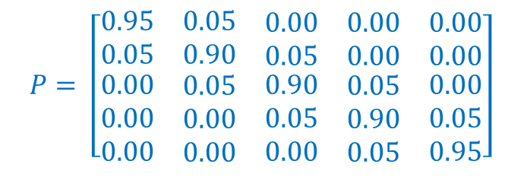
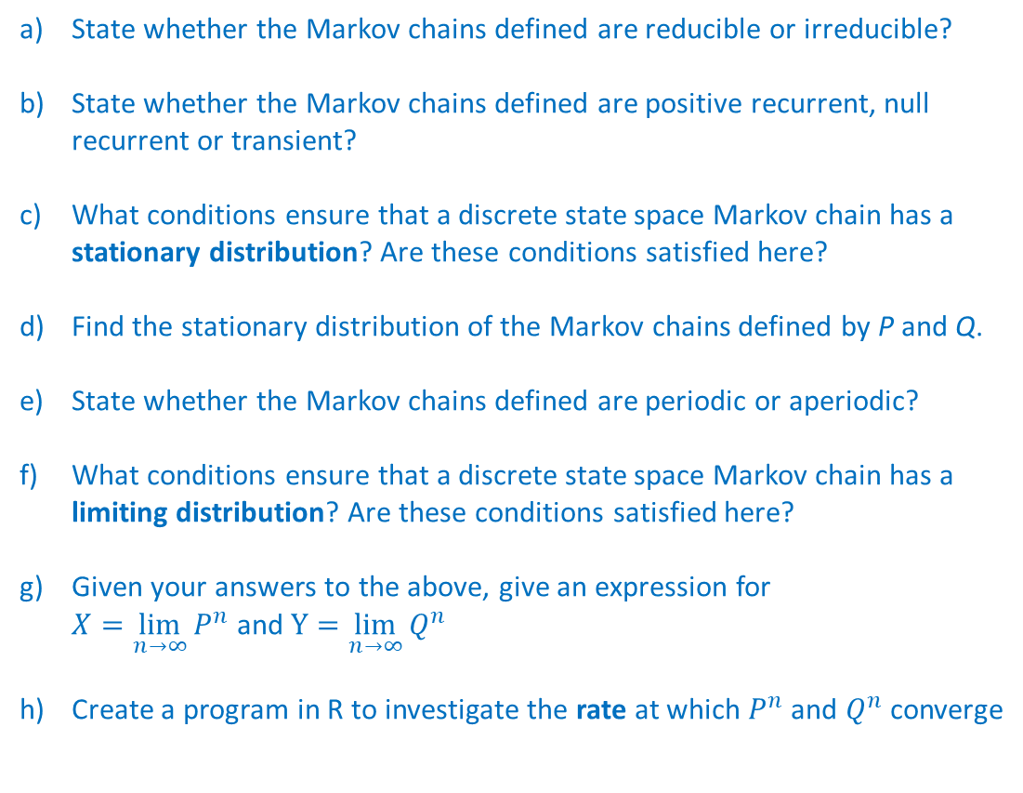
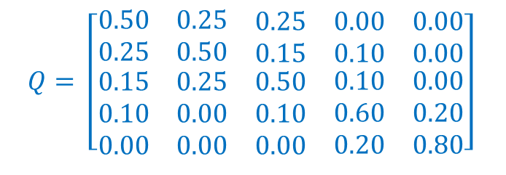
Question 4:
Question 4
Consider the following discrete state space Markov chains defined by the following transition matrices
State whether the Markov chains defined are reducible or irreducible?
State whether the Markov chains defined are positive recurrent, null recurrent or transient?
What conditions ensure that a discrete state space Markov chain has a stationary distribution? Are these conditions satisfied here?
Find the stationary distribution of the Markov chains defined by P and Q.
State whether the Markov chains defined are periodic or aperiodic?
What conditions ensure that a discrete state space Markov chain has a limiting distribution? Are these conditions satisfied here?
Given your answers to the above, give an expression for $X=\lim_{n→∞}{P^{n}}$ and $Y=\lim_{n→∞}{Q^{n}}$
Create a program in R to investigate the rate at which $P^{n}$ and $Q^{n}$ converge
$$P= \left[\begin{matrix}0.95 & 0.05 & \begin{matrix}0.00 & 0.00 & 0.00\end{matrix} \\ 0.05 & 0.90 & \begin{matrix}0.05 & 0.00 & 0.00\end{matrix} \\ \begin{matrix}0.00 \\ 0.00 \\ 0.00\end{matrix} & \begin{matrix}0.05 \\ 0.00 \\ 0.00\end{matrix} & \begin{matrix}\begin{matrix}0.90 \\ 0.05 \\ 0.00\end{matrix} & \begin{matrix}0.05 \\ 0.90 \\ 0.05\end{matrix} & \begin{matrix}0.00 \\ 0.05 \\ 0.95\end{matrix}\end{matrix}\end{matrix}\right]$$
$$Q= \left[\begin{matrix}0.50 & 0.25 & \begin{matrix}0.25 & 0.00 & 0.00\end{matrix} \\ 0.25 & 0.50 & \begin{matrix}0.15 & 0.10 & 0.00\end{matrix} \\ \begin{matrix}0.15 \\ 0.10 \\ 0.00\end{matrix} & \begin{matrix}0.25 \\ 0.00 \\ 0.00\end{matrix} & \begin{matrix}\begin{matrix}0.50 \\ 0.10 \\ 0.00\end{matrix} & \begin{matrix}0.10 \\ 0.60 \\ 0.20\end{matrix} & \begin{matrix}0.00 \\ 0.20 \\ 0.80\end{matrix}\end{matrix}\end{matrix}\right]$$
13
Associated code = Tutorial 4 – Q4

Slide 14
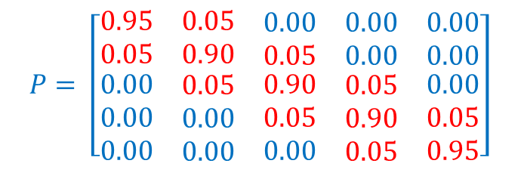
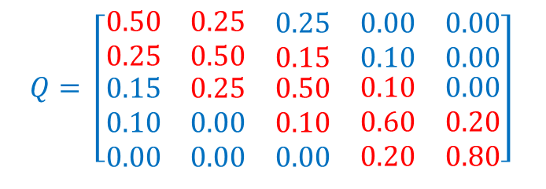
Question 4:
Question 4
State whether the Markov chains defined are reducible or irreducible? All states communicate with each other, so the chain is irreducible. This is obvious because the ‘main-diagonal’ terms shown in red in either matrix are non-zero.
State whether the Markov chains defined are positive recurrent, null recurrent or transient? Both chains have a finite state space and are irreducible. Therefore, they are both positive recurrent. An irreducible chain with a finite state space cannot have a transient state, otherwise all states would be transient and the chain would only return to each state a finite number of times. Likewise, an irreducible chain with a finite state space cannot have a null recurrent state, otherwise all states would by null recurrent and the expected return time to each state would be infinite.
What conditions ensure that a discrete state space Markov chain has a stationary distribution? Are these conditions satisfied here? If a discrete state space Markov chain is irreducible and positive recurrent, then it has a stationary distribution (see Theorem 5 of lecture notes). Both Markov chains satisfy these conditions and so both have a stationary distribution.
$$P= \left[\begin{matrix}0.95 & 0.05 & \begin{matrix}0.00 & 0.00 & 0.00\end{matrix} \\ 0.05 & 0.90 & \begin{matrix}0.05 & 0.00 & 0.00\end{matrix} \\ \begin{matrix}0.00 \\ 0.00 \\ 0.00\end{matrix} & \begin{matrix}0.05 \\ 0.00 \\ 0.00\end{matrix} & \begin{matrix}\begin{matrix}0.90 \\ 0.05 \\ 0.00\end{matrix} & \begin{matrix}0.05 \\ 0.90 \\ 0.05\end{matrix} & \begin{matrix}0.00 \\ 0.05 \\ 0.95\end{matrix}\end{matrix}\end{matrix}\right]$$
$$Q= \left[\begin{matrix}0.50 & 0.25 & \begin{matrix}0.25 & 0.00 & 0.00\end{matrix} \\ 0.25 & 0.50 & \begin{matrix}0.15 & 0.10 & 0.00\end{matrix} \\ \begin{matrix}0.15 \\ 0.10 \\ 0.00\end{matrix} & \begin{matrix}0.25 \\ 0.00 \\ 0.00\end{matrix} & \begin{matrix}\begin{matrix}0.50 \\ 0.10 \\ 0.00\end{matrix} & \begin{matrix}0.10 \\ 0.60 \\ 0.20\end{matrix} & \begin{matrix}0.00 \\ 0.20 \\ 0.80\end{matrix}\end{matrix}\end{matrix}\right]$$
14
Associated code = Tutorial 4 – Q4

Slide 15
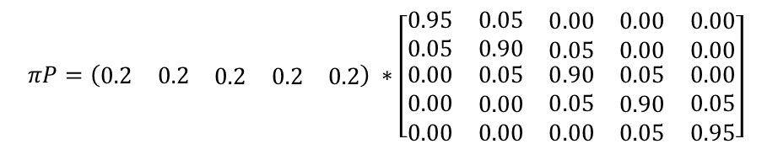

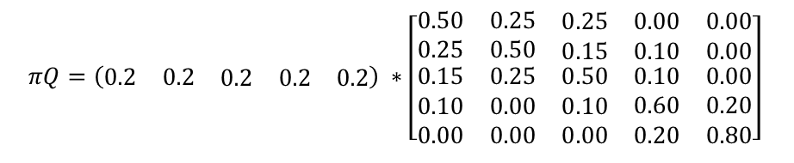

Question 4:
Question 4
Find the stationary distribution of the Markov chains defined by P and Q
# 1.1a - Define transition matrix P
statenames <- c("1", "2", "3", "4" , "5" )
P <- matrix( c(
0.95, 0.05, 0.00, 0.00, 0.00,
0.05, 0.90, 0.05, 0.00, 0.00,
0.00, 0.05, 0.90, 0.05, 0.00,
0.00, 0.00, 0.05, 0.90, 0.05,
0.00, 0.00, 0.00, 0.05, 0.95), nrow=5, byrow=TRUE,
dimnames = list(statenames, statenames))
# 1.1b - Specifying that the transition matrix P defines a Markov chain
mcp <- new("markovchain", transitionMatrix=P)
# 1.1c - Determine the stationary distribution of the Markov chain defined by P
steadyStates(mcp)
1 2 3 4 5
[1,] 0.2 0.2 0.2 0.2 0.2
# 1.1d - Define transition matrix Q
statenames <- c("1", "2", "3", "4" , "5" )
Q <- matrix( c(
0.50, 0.25, 0.25, 0.00, 0.00,
0.25, 0.50, 0.15, 0.10, 0.00,
0.15, 0.25, 0.50, 0.10, 0.00,
0.10, 0.00, 0.10, 0.60, 0.20,
0.00, 0.00, 0.00, 0.20, 0.80), nrow=5, byrow=TRUE,
dimnames = list(statenames, statenames))
# 1.1e - Specifying that the transition matrix Q defines a Markov chain
mcq <- new("markovchain", transitionMatrix=Q)
# 1.1f - Determine the stationary distribution of the Markov chain defined by Q
steadyStates(mcq)
1 2 3 4 5
[1,] 0.2 0.2 0.2 0.2 0.2
$$πP=\left(\begin{matrix}0.2 & 0.2 & \begin{matrix}0.2 & 0.2 & 0.2\end{matrix}\end{matrix}\right) ∗\left[\begin{matrix}0.95 & 0.05 & \begin{matrix}0.00 & 0.00 & 0.00\end{matrix} \\ 0.05 & 0.90 & \begin{matrix}0.05 & 0.00 & 0.00\end{matrix} \\ \begin{matrix}0.00 \\ 0.00 \\ 0.00\end{matrix} & \begin{matrix}0.05 \\ 0.00 \\ 0.00\end{matrix} & \begin{matrix}\begin{matrix}0.90 \\ 0.05 \\ 0.00\end{matrix} & \begin{matrix}0.05 \\ 0.90 \\ 0.05\end{matrix} & \begin{matrix}0.00 \\ 0.05 \\ 0.95\end{matrix}\end{matrix}\end{matrix}\right]$$
$$πQ=\left(\begin{matrix}0.2 & 0.2 & \begin{matrix}0.2 & 0.2 & 0.2\end{matrix}\end{matrix}\right) ∗\left[\begin{matrix}0.50 & 0.25 & \begin{matrix}0.25 & 0.00 & 0.00\end{matrix} \\ 0.25 & 0.50 & \begin{matrix}0.15 & 0.10 & 0.00\end{matrix} \\ \begin{matrix}0.15 \\ 0.10 \\ 0.00\end{matrix} & \begin{matrix}0.25 \\ 0.00 \\ 0.00\end{matrix} & \begin{matrix}\begin{matrix}0.50 \\ 0.10 \\ 0.00\end{matrix} & \begin{matrix}0.10 \\ 0.60 \\ 0.20\end{matrix} & \begin{matrix}0.00 \\ 0.20 \\ 0.80\end{matrix}\end{matrix}\end{matrix}\right]$$
$$=\left(\begin{matrix}0.2 & 0.2 & \begin{matrix}0.2 & 0.2 & 0.2\end{matrix}\end{matrix}\right) = π$$
$$=\left(\begin{matrix}0.2 & 0.2 & \begin{matrix}0.2 & 0.2 & 0.2\end{matrix}\end{matrix}\right) = π$$
Both Markov chains have the same stationary distribution!
15
Associated code = Tutorial 4 – Q4

Slide 16
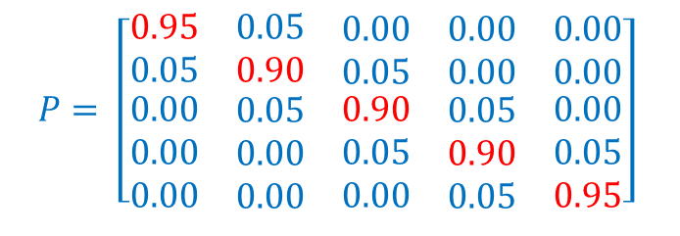
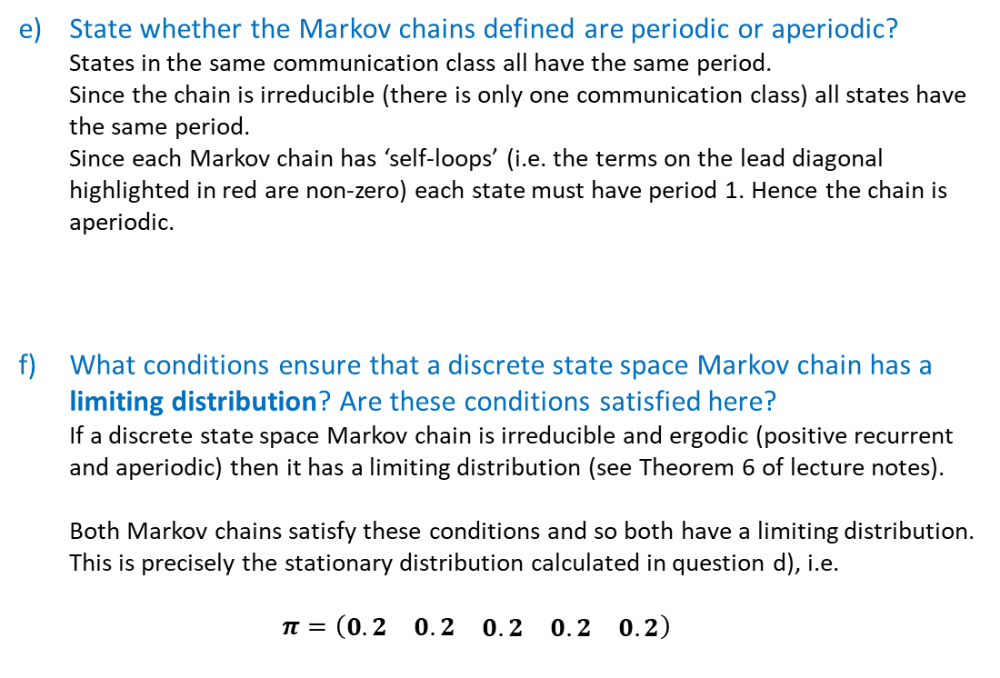
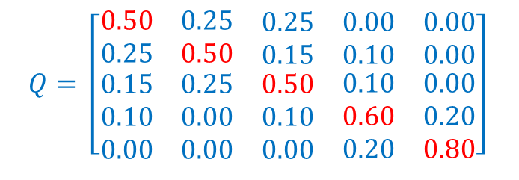
Question 4:
Question 4
State whether the Markov chains defined are periodic or aperiodic? States in the same communication class all have the same period. Since the chain is irreducible (there is only one communication class) all states have the same period. Since each Markov chain has ‘self-loops’ (i.e. the terms on the lead diagonal highlighted in red are non-zero) each state must have period 1. Hence the chain is aperiodic.
What conditions ensure that a discrete state space Markov chain has a limiting distribution? Are these conditions satisfied here? If a discrete state space Markov chain is irreducible and ergodic (positive recurrent and aperiodic) then it has a limiting distribution (see Theorem 6 of lecture notes). Both Markov chains satisfy these conditions and so both have a limiting distribution. This is precisely the stationary distribution calculated in question d), i.e. $π=\left(\begin{matrix}0.2 & 0.2 & \begin{matrix}0.2 & 0.2 & 0.2\end{matrix}\end{matrix}\right)$
$$P= \left[\begin{matrix}0.95 & 0.05 & \begin{matrix}0.00 & 0.00 & 0.00\end{matrix} \\ 0.05 & 0.90 & \begin{matrix}0.05 & 0.00 & 0.00\end{matrix} \\ \begin{matrix}0.00 \\ 0.00 \\ 0.00\end{matrix} & \begin{matrix}0.05 \\ 0.00 \\ 0.00\end{matrix} & \begin{matrix}\begin{matrix}0.90 \\ 0.05 \\ 0.00\end{matrix} & \begin{matrix}0.05 \\ 0.90 \\ 0.05\end{matrix} & \begin{matrix}0.00 \\ 0.05 \\ 0.95\end{matrix}\end{matrix}\end{matrix}\right]$$
$$Q= \left[\begin{matrix}0.50 & 0.25 & \begin{matrix}0.25 & 0.00 & 0.00\end{matrix} \\ 0.25 & 0.50 & \begin{matrix}0.15 & 0.10 & 0.00\end{matrix} \\ \begin{matrix}0.15 \\ 0.10 \\ 0.00\end{matrix} & \begin{matrix}0.25 \\ 0.00 \\ 0.00\end{matrix} & \begin{matrix}\begin{matrix}0.50 \\ 0.10 \\ 0.00\end{matrix} & \begin{matrix}0.10 \\ 0.60 \\ 0.20\end{matrix} & \begin{matrix}0.00 \\ 0.20 \\ 0.80\end{matrix}\end{matrix}\end{matrix}\right]$$
16
Associated code = Tutorial 4 – Q4

Slide 17
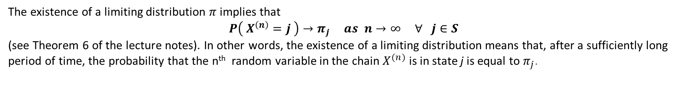
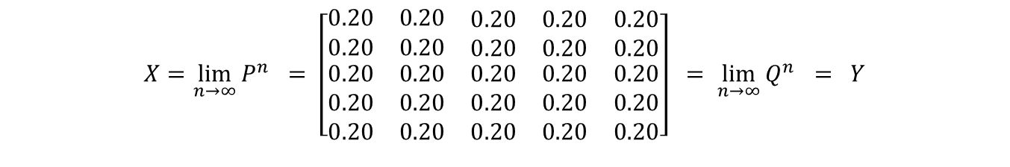
Question 4:
Question 4
Given your answers to the above, give an expression for $X=\lim_{n→∞}{P^{n}}$ and $Y=\lim_{n→∞}{Q^{n}}$
The existence of a limiting distribution $π$ implies that $$P\left( X^{\left(n\right)}=j \right)→π_{j} as n→∞ ∀ j∈S$$ (see Theorem 6 of the lecture notes). In other words, the existence of a limiting distribution means that, after a sufficiently long period of time, the probability that the n^{th} random variable in the chain $X^{(n)}$ is in state j is equal to $π_{j}$.
In the context of this question, since $π=\left(\begin{matrix}0.2 & 0.2 & \begin{matrix}0.2 & 0.2 & 0.2\end{matrix}\end{matrix}\right)$we will have have that...
$$X=\lim_{n→∞}{P^{n}} = \left[\begin{matrix}0.20 & 0.20 & \begin{matrix}0.20 & 0.20 & 0.20\end{matrix} \\ 0.20 & 0.20 & \begin{matrix}0.20 & 0.20 & 0.20\end{matrix} \\ \begin{matrix}0.20 \\ 0.20 \\ 0.20\end{matrix} & \begin{matrix}0.20 \\ 0.20 \\ 0.20\end{matrix} & \begin{matrix}\begin{matrix}0.20 \\ 0.20 \\ 0.20\end{matrix} & \begin{matrix}0.20 \\ 0.20 \\ 0.20\end{matrix} & \begin{matrix}0.20 \\ 0.20 \\ 0.20\end{matrix}\end{matrix}\end{matrix}\right] =\lim_{n→∞}{Q^{n}} = Y$$
For either Markov chain, after a sufficiently long period of time, there is an equal chance that the chain is in each state.
17
Associated code = Tutorial 4 – Q4

Slide 18
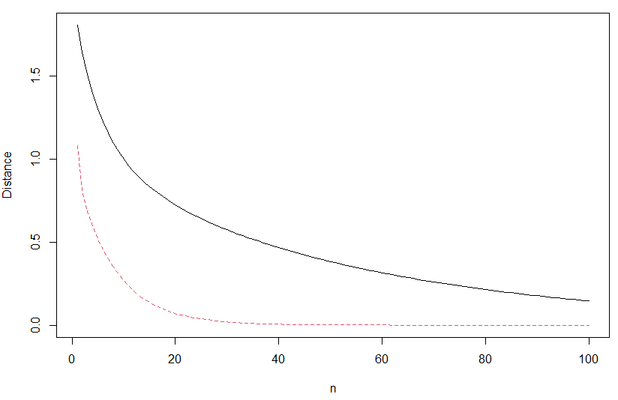


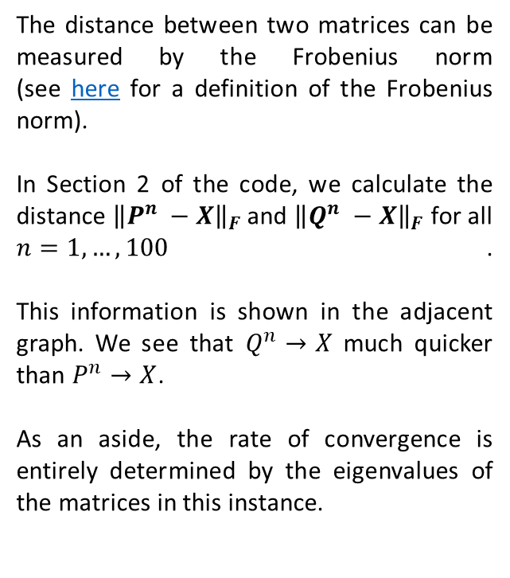
Question 4:
Question 4
Create a program in R to investigate the rate at which $P^{n}$ and $Q^{n}$ converge
See Section 2 of the code
Rate of Convergence to Limiting Distribution in the Frobenius Norm
The distance between two matrices can be measured by the Frobenius norm (see here for a definition of the Frobenius norm).
In Section 2 of the code, we calculate the distance ${\left\|P^{n} −X\right\|}_{F}$ and ${\left\|Q^{n} −X\right\|}_{F}$ for all $n=1, …, 100$. This information is shown in the adjacent graph. We see that $Q^{n}→X$ much quicker than $P^{n}→X$.
As an aside, the rate of convergence is entirely determined by the eigenvalues of the matrices in this instance.
$${\left\|P^{n} −X\right\|}_{F}$$
$${\left\|Q^{n} −X\right\|}_{F}$$
18
Associated code = Tutorial 4 – Q4

